Slide 1
Mythical creatures
Extremadura

Slide 2
Introduction
We are going to talk about all the mythical creatures that are traditional in our region. Some are nice, some are scary, but they are all original from Extremadura. Our favourite are: Lobisome, the Bogeyman and the Elves. We hope you enjoy what we have prepared.

Slide 3
B
These are common origins where the mythical creatures in Extremadura used to live.
A
C
Sierra de Gata
Hurdes Mountains
La Vera

Slide 4
What is a Werewolf?
A werewolf or werwolf, also known as a lycanthrope, is a mythological human with the ability to change into a wolf or another creature, either purposely, by being bitten or scratched by another werewolf, or after being placed under a curse. This transformation is often associated with the appearance of the full moon.

Slide 5
Lobisome’s origins

Slide 6
Lobisome’s origins
León

Slide 7
Lobisome’s origins
León
Galicia y Portugal

Slide 8
Lobisome’s origins
Asturias Occidental
León
Galicia y Portugal

Slide 9
Lobisome’s origins
Asturias Occidental
León
Sierra de Gata
Galicia y Portugal

Slide 10
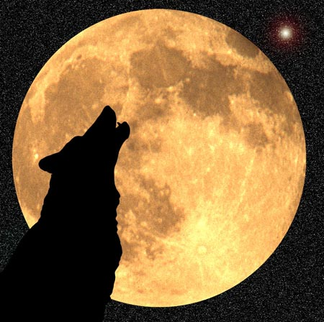
The Myth
The seventh son (they all must be boys, with no girls in the middle) will become a werewolf on the 24th of June (San Juan) or when there is a full moon. They can also become werewolves with a curse.

Slide 11
The Myth
They can become a human by letting blood out and burning their skin. They can avoid being one by being baptized by the oldest son and naming him Antonio.

Slide 12
The Myth
If it were the case of there being seven girls, the seventh would become a witch.

Slide 13
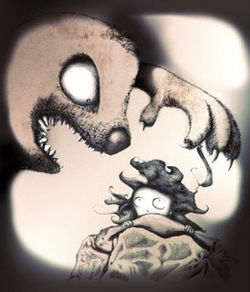
The bogeyman
«El Coco» is the scary monster that for other children in the world would be the monster that hides under the bed, and he will eat them if they don’t go to sleep early. It’s the best way to make children go to sleep.

Slide 14
The bogeyman
Different countries call «El Coco» in different ways: Cucuy (Mexico) Coconiano (Cuba) Cucufo (Perú) Chamuco (¿?)

Slide 15
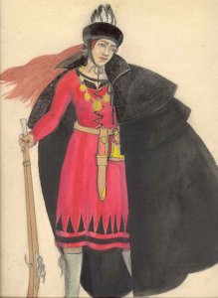
La chancalaera
The «chancalaera» is very similar to la Serrana de la Vera.

Slide 16
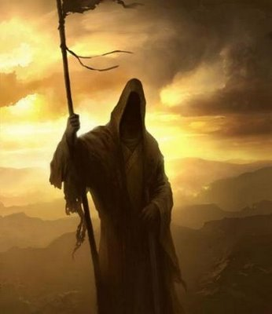
La Genti de Muerti
This myth is about a couple that ride a horse and vanish into the fog. If you ask them who they are, they will answer «Genti de Muerti». They look for a soul that will die every night.

Slide 17
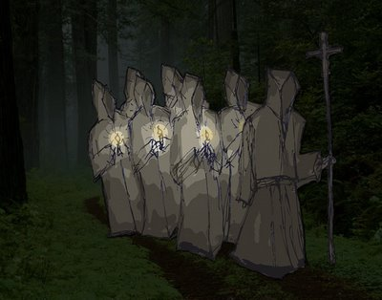
The Souls procession
It is a procession where all unhappy souls march with white clothes and a white candle. If you stop them, you will die immediatly.

Slide 18
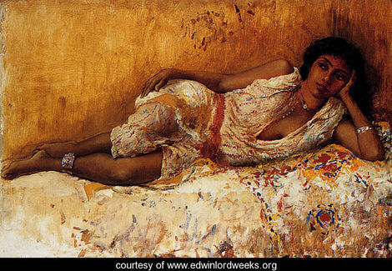
The Enchated Moorish Lady
This myth is about women who are lonely and live in far away castles. They also have superpowers. They are very beautiful, and they are combing their hair all day waiting for a handsome man to fetch them.

Slide 19
«El Machu Lanú»
It is mysterious mythical creature that has a goat body, a strong voice, man face and some horns. It lives in the mountains.

Slide 20
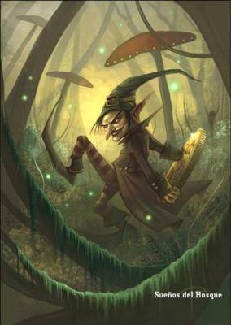
Elves
These are little people with priest clothes or like little ogres. In different zones in Extremadura, they had different names:
Hurdes Mountains: «Duendi Jampón»
Jerte valley: «Pomporilla»

Slide 21
Elves
The elves in «Garganta la Olla» made women not fertille, they couldn’t be pregnant. The elves were 40cm tall green and human-shaped. If someone accidentally saw them, they would escape running in zig-zag.

Slide 22
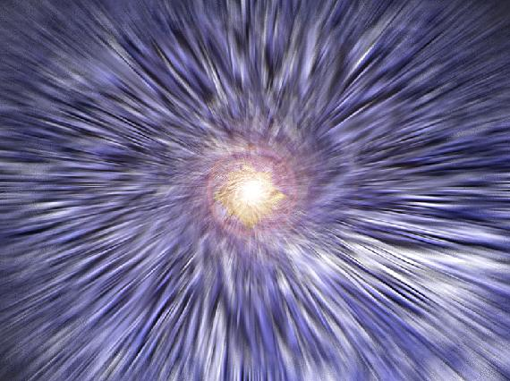
A small description of the Afterlife
The dead souls chase the living souls at night. If they haven’t got many sins to pay, they go to Heaven, if they have lots to pay, go to the desert, where the ones in heaven send storms. When the ones in the desert have suffered, they go to Heaven.

Slide 23
Scary things
Many of the scary things in Extremadura have already been mentioned. We still have to mention «the black hand», «Tragantía» and «pardillín». We aren’t explaining these. We are just mentioning them.

Slide 24
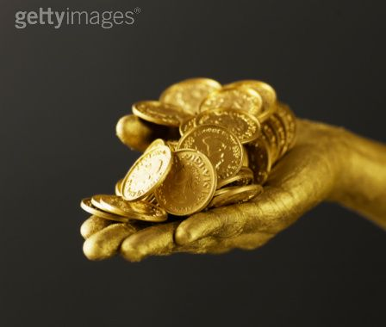
The Golden Hand
In the Jerte Valley, there was a mysterious Golden Hand. This hand would kill cattle, leaving a mark, as if it were from a hand on fire.

Slide 25
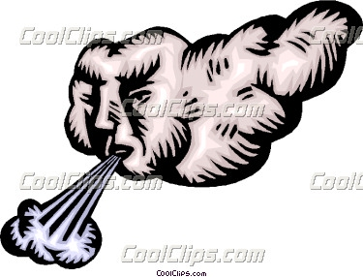
«Lus malus vientus»
This myth is about a wind that took the cattle from shepherds making them disappear, and not long after that, mysteriously put the cattle back

Slide 26
La Encorujá
This evil woman transforms into light and steals babies from their cribs and makes them appear in random places like in a pen or in houses.

Slide 27
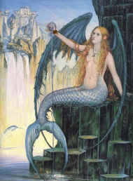
Mermaids
These mermaids live in rivers. They aren’t benevolent creatures. They sing charming songs to bring innocent shepherds and then later on drown them.

Slide 28
Los Zajorilis Hurdanos
These were wise people that could easily predict where subterranean water was. They carried a stick that gave them wisdom.

Slide 29
Jáncanas
These horrible women lived in caves in the mountains. They could transform into whatever they liked (snakes, lovely ladies…). They normally killed shepherds with a pair of golden scissors.

Slide 30
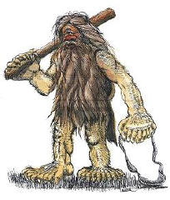
Jáncanu
These are similar to the Cyclops. They wear animal skins, they have got a big and full-of-fur body and only one eye, but they have a good eye sight. They are evil and cannibals, they also live in caves in the mountains.

Slide 31
Encontráu
This is a disease that is quite terrifying: If you look at an animal that has the «encontráu», you will catch it too. You can heal the person with garments of a person named Mary or John, but only with the person of the opposite sex, while reciting a spell.

Slide 32
Entiznáu
This myth is about a 4-metre tall man that wears dark clothes, a big hat and his face is black. His powers consist on creating storms, thunder and rain. He is very irascible, especially when the shepherds refused his offerings. One of his enemies is “The Chancalaera”.

Slide 33
Escornáu
It’s a huge living being that has horse body, Boar front and a huge horn on his forehead. It attacked people and cattle and it finally died when a divine force stopped him in front of a banner of the Virgin. Its horn had healing powers and it was considered a relic.

Slide 34
Conclusion
We hope you have enjoyed our presentation. We are going to ask you some questions to see your opinion about the mythical creatures of Extremadura. See you soon! ☺

